Slide 1
Keys, Join, and Union
Module 2: 03

Slide 2
Objectives
Keys
Cardinality
Joins
Unions

Slide 3
Primary Keys
Primary Keys are used to uniquely identify a row on a table.
Natural Key - a unique value in the data that can be used to identify a specific row on the table. (example a student id)
Surrogate Key - a generated unique value that is used when no natural key is available (example a sequentially generated number)
Composite Key - when a 2 or more columns are used as the key to identify a unique row on a table. (example a card suit and rank)

Slide 4
Natural Composite Primary Key
Surrogate Primary Key
suit | value | times_played
Hearts | Ace | 5
Diamonds | Three | 2
Hearts | Jack | 4
Spades | Ace | 1
id | first_name | last_name
1 | Jack | Burton
2 | Gracie | Law
3 | Eddie | Lee
primary key - surrogate key. There is no value in the data that identifies a unique value, so a unique value is generated for each row.
primary key - composite natural key. One column is not enough to identify a unique value, but together they form a unique key

Slide 5
Foreign Key
A foreign key Exist in other tables to reference a unique related row in the source table. Used to create relationships between tables.
Usually References a primary key, but can reference any column that contains a unique value that can be used to identify a specific row.
Can reference a composite key, but all columns that make up the primary key on the source table must be referenced on the table.
Country
City
code | name
USA | United States
GBR | Great Britain
CAN | Canada
id | countrycode | name
1 | USA | United States
2 | GBR | Great Britain
3 | CAN | Canada
The country table’s primary key, code, is a foreign key on the City table to reference what country a city is in.

Slide 6
Cardinality
Degrees of Cardinality
One-to-One (1:1) - One entity of data on a table relates to a single entity of data on another table.
One-to-Many (1:N) - One entity of data on a table relates to a multiple entities of data on another table.
Many-to-Many (M:N) - Multiple entities of data on a table relates to a multiple entities of data on another table.

Slide 7
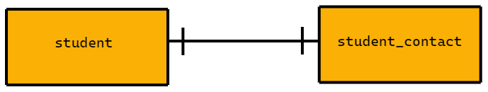
One-to-One (1:1) Cardinality
An entity on one table relates to a single entity on a second table.
A student can have one student contact, and a student contact can only be related to one student.
Requires no extra tables, a foreign key can be used either way without duplicating data.

Slide 8
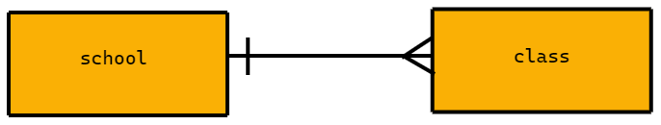
One-to-Many (1:N) Cardinality
An entity on one table can relate to multiple entities on a second table.
A School can have multiple classes, but a class can only be related to one school. .
Requires no extra table, the table on the 1 side’s primary key can be added to the table with the M relationships without duplication of data

Slide 9
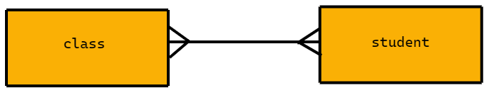
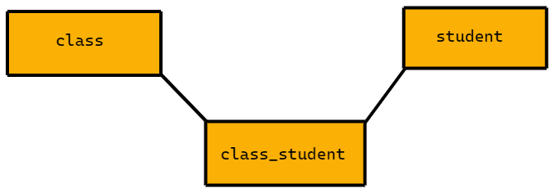
Many-to-Many (M:N) Cardinality
Each entity on a table can relate to multiple entities on a second table.
A class can have multiple students, and a student may have multiple classes.
Requires a join table that contains just the primary keys of both tables to avoid duplicating data
A Many-to-Many Relationship REQUIRES a join table

Slide 10
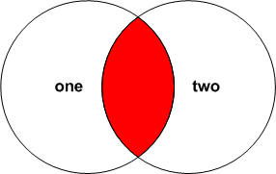
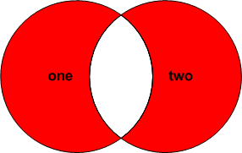
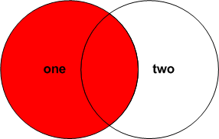
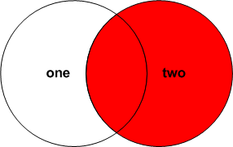
Joins
SQL JOINs allow us to create queries that produce data from one or more tables.
Related records are "joined" into a single result.
Joins are referred to as INNER and OUTER.
The tables involved in a JOIN are referred to as LEFT and RIGHT.
INNER
OUTER
LEFT
RIGHT

Slide 11
Tables
Table one
number | description
100 | ONE - 100
101 | ONE - 101
102 | ONE - 102
103 | ONE - 103
104 | ONE - 104
105 | ONE - 105
990 | ONE-BOTH - 990
991 | ONE-BOTH - 991
992 | ONE-BOTH - 992
993 | ONE-BOTH - 993
994 | ONE-BOTH - 994
995 | ONE-BOTH - 995
Table two
number | description
200 | TWO - 200
201 | TWO - 201
202 | TWO - 202
203 | TWO - 203
204 | TWO - 204
205 | TWO - 205
990 | TWO-BOTH - 990
991 | TWO-BOTH - 991
992 | TWO-BOTH - 992
993 | TWO-BOTH - 993
994 | TWO-BOTH - 994
995 | TWO-BOTH - 995

Slide 12
Tables joined on number
on.number | one.description | two.number | two.description
100 | ONE - 100 | null | null
101 | ONE - 101 | null | null
102 | ONE - 102 | null | null
103 | ONE - 103 | null | null
104 | ONE - 104 | null | null
105 | ONE - 105 | null | null
990 | ONE-BOTH - 990 | 990 | TWO-BOTH - 990
991 | ONE-BOTH - 991 | 991 | TWO-BOTH - 991
992 | ONE-BOTH - 992 | 992 | TWO-BOTH - 992
993 | ONE-BOTH - 993 | 993 | TWO-BOTH - 993
994 | ONE-BOTH - 994 | 994 | TWO-BOTH - 994
995 | ONE-BOTH - 995 | 995 | TWO-BOTH - 995
null | null | 200 | TWO - 200
null | null | 201 | TWO - 201
null | null | 202 | TWO - 202
null | null | 203 | TWO - 203
null | null | 204 | TWO - 204
null | null | 205 | TWO - 205

Slide 13
Inner Join
(Default)
Tables joined on number
on.number | one.description | two.number | two.description
100 | ONE - 100 | null | null
101 | ONE - 101 | null | null
102 | ONE - 102 | null | null
103 | ONE - 103 | null | null
104 | ONE - 104 | null | null
105 | ONE - 105 | null | null
990 | ONE-BOTH - 990 | 990 | TWO-BOTH - 990
991 | ONE-BOTH - 991 | 991 | TWO-BOTH - 991
992 | ONE-BOTH - 992 | 992 | TWO-BOTH - 992
993 | ONE-BOTH - 993 | 993 | TWO-BOTH - 993
994 | ONE-BOTH - 994 | 994 | TWO-BOTH - 994
995 | ONE-BOTH - 995 | 995 | TWO-BOTH - 995
null | null | 200 | TWO - 200
null | null | 201 | TWO - 201
null | null | 202 | TWO - 202
null | null | 203 | TWO - 203
null | null | 204 | TWO - 204
null | null | 205 | TWO - 205
SELECT one.number AS one_number, one.description as one_description, two.number as two_number, two.description as two_description
FROM one
JOIN two ON one.number = two.number

Slide 14
Left Join
( Left Outer Join )
Tables joined on number
on.number | one.description | two.number | two.description
100 | ONE - 100 | null | null
101 | ONE - 101 | null | null
102 | ONE - 102 | null | null
103 | ONE - 103 | null | null
104 | ONE - 104 | null | null
105 | ONE - 105 | null | null
990 | ONE-BOTH - 990 | 990 | TWO-BOTH - 990
991 | ONE-BOTH - 991 | 991 | TWO-BOTH - 991
992 | ONE-BOTH - 992 | 992 | TWO-BOTH - 992
993 | ONE-BOTH - 993 | 993 | TWO-BOTH - 993
994 | ONE-BOTH - 994 | 994 | TWO-BOTH - 994
995 | ONE-BOTH - 995 | 995 | TWO-BOTH - 995
null | null | 200 | TWO - 200
null | null | 201 | TWO - 201
null | null | 202 | TWO - 202
null | null | 203 | TWO - 203
null | null | 204 | TWO - 204
null | null | 205 | TWO - 205
SELECT one.number AS one_number, one.description as one_description, two.number as two_number, two.description as two_description
FROM one
LEFT JOIN two ON one.number = two.number

Slide 15
Right Join
( Right Outer Join )
Tables joined on number
on.number | one.description | two.number | two.description
100 | ONE - 100 | null | null
101 | ONE - 101 | null | null
102 | ONE - 102 | null | null
103 | ONE - 103 | null | null
104 | ONE - 104 | null | null
105 | ONE - 105 | null | null
990 | ONE-BOTH - 990 | 990 | TWO-BOTH - 990
991 | ONE-BOTH - 991 | 991 | TWO-BOTH - 991
992 | ONE-BOTH - 992 | 992 | TWO-BOTH - 992
993 | ONE-BOTH - 993 | 993 | TWO-BOTH - 993
994 | ONE-BOTH - 994 | 994 | TWO-BOTH - 994
995 | ONE-BOTH - 995 | 995 | TWO-BOTH - 995
null | null | 200 | TWO - 200
null | null | 201 | TWO - 201
null | null | 202 | TWO - 202
null | null | 203 | TWO - 203
null | null | 204 | TWO - 204
null | null | 205 | TWO - 205
SELECT one.number AS one_number, one.description as one_description, two.number as two_number, two.description as two_description
FROM one
RIGHT JOIN two ON one.number = two.number

Slide 16
Popular Interview Question...
Question: What is the difference between a LEFT JOIN and a LEFT OUTER JOIN?
Answer: Nothing, they are the same!
Question: What is the difference between a RIGHT JOIN and RIGHT OUTER JOIN?
Answer: Nothing, they are the same!

Slide 17
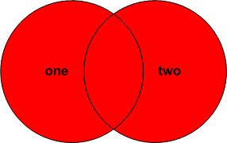
Full Outer Join
Tables joined on number
on.number | one.description | two.number | two.description
100 | ONE - 100 | null | null
101 | ONE - 101 | null | null
102 | ONE - 102 | null | null
103 | ONE - 103 | null | null
104 | ONE - 104 | null | null
105 | ONE - 105 | null | null
990 | ONE-BOTH - 990 | 990 | TWO-BOTH - 990
991 | ONE-BOTH - 991 | 991 | TWO-BOTH - 991
992 | ONE-BOTH - 992 | 992 | TWO-BOTH - 992
993 | ONE-BOTH - 993 | 993 | TWO-BOTH - 993
994 | ONE-BOTH - 994 | 994 | TWO-BOTH - 994
995 | ONE-BOTH - 995 | 995 | TWO-BOTH - 995
null | null | 200 | TWO - 200
null | null | 201 | TWO - 201
null | null | 202 | TWO - 202
null | null | 203 | TWO - 203
null | null | 204 | TWO - 204
null | null | 205 | TWO - 205
SELECT one.number AS one_number, one.description as one_description, two.number as two_number, two.description as two_description
FROM one
FULL OUTER JOIN two ON one.number = two.number

Slide 18
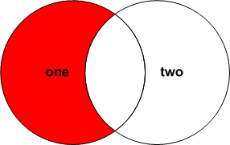
Only the Left Table Values
(Unnamed)
Tables joined on number
on.number | one.description | two.number | two.description
100 | ONE - 100 | null | null
101 | ONE - 101 | null | null
102 | ONE - 102 | null | null
103 | ONE - 103 | null | null
104 | ONE - 104 | null | null
105 | ONE - 105 | null | null
990 | ONE-BOTH - 990 | 990 | TWO-BOTH - 990
991 | ONE-BOTH - 991 | 991 | TWO-BOTH - 991
992 | ONE-BOTH - 992 | 992 | TWO-BOTH - 992
993 | ONE-BOTH - 993 | 993 | TWO-BOTH - 993
994 | ONE-BOTH - 994 | 994 | TWO-BOTH - 994
995 | ONE-BOTH - 995 | 995 | TWO-BOTH - 995
null | null | 200 | TWO - 200
null | null | 201 | TWO - 201
null | null | 202 | TWO - 202
null | null | 203 | TWO - 203
null | null | 204 | TWO - 204
null | null | 205 | TWO - 205
SELECT one.number AS one_number, one.description as one_description, two.number as two_number, two.description as two_description
FROM one
LEFT JOIN two ON one.number = two.number
WHERE two.number IS NULL

Slide 19
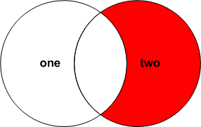
Only the Right Table Values
(Unnamed)
Tables joined on number
on.number | one.description | two.number | two.description
100 | ONE - 100 | null | null
101 | ONE - 101 | null | null
102 | ONE - 102 | null | null
103 | ONE - 103 | null | null
104 | ONE - 104 | null | null
105 | ONE - 105 | null | null
990 | ONE-BOTH - 990 | 990 | TWO-BOTH - 990
991 | ONE-BOTH - 991 | 991 | TWO-BOTH - 991
992 | ONE-BOTH - 992 | 992 | TWO-BOTH - 992
993 | ONE-BOTH - 993 | 993 | TWO-BOTH - 993
994 | ONE-BOTH - 994 | 994 | TWO-BOTH - 994
995 | ONE-BOTH - 995 | 995 | TWO-BOTH - 995
null | null | 200 | TWO - 200
null | null | 201 | TWO - 201
null | null | 202 | TWO - 202
null | null | 203 | TWO - 203
null | null | 204 | TWO - 204
null | null | 205 | TWO - 205
SELECT one.number AS one_number, one.description as one_description, two.number as two_number, two.description as two_description
FROM one
RIGHT JOIN two ON one.number = two.number
WHERE one.number IS NULL

Slide 20
In the LEFT or RIGHT, but not both
(Unnamed)
Tables joined on number
on.number | one.description | two.number | two.description
100 | ONE - 100 | null | null
101 | ONE - 101 | null | null
102 | ONE - 102 | null | null
103 | ONE - 103 | null | null
104 | ONE - 104 | null | null
105 | ONE - 105 | null | null
990 | ONE-BOTH - 990 | 990 | TWO-BOTH - 990
991 | ONE-BOTH - 991 | 991 | TWO-BOTH - 991
992 | ONE-BOTH - 992 | 992 | TWO-BOTH - 992
993 | ONE-BOTH - 993 | 993 | TWO-BOTH - 993
994 | ONE-BOTH - 994 | 994 | TWO-BOTH - 994
995 | ONE-BOTH - 995 | 995 | TWO-BOTH - 995
null | null | 200 | TWO - 200
null | null | 201 | TWO - 201
null | null | 202 | TWO - 202
null | null | 203 | TWO - 203
null | null | 204 | TWO - 204
null | null | 205 | TWO - 205
SELECT one.number AS one_number, one.description as one_description, two.number as two_number, two.description as two_description
FROM one
FULL OUTER JOIN two ON one.number = two.number
WHERE one.number IS NULL OR two.number IS NULL

Slide 21
Installing the DVDStore Database (Required)
In terminal, CD to the directory with the dvdstore.sql file
yourname-java-blue/module-2/03_Joins/lecture-student/database
Create the Database (don’t cut and paste the quotes)
psql -U postgres -c “CREATE DATABASE dvdstore”
Load the structure and data
psql -U postgres -d dvdstore -f dvdstore.sql
password: postgres1

Slide 22
Union
A SQL UNION combines the results of two or more queries into a single result set.
The number of columns involved must match exactly and data types must be identical.
Duplicate rows are removed.
A good example for this is a database that might have faculty and students separated into different tables but we want to return all people who attend or work at a school.
SELECT expression1, expression2, ... expression_n FROM tables [WHERE conditions] UNION SELECT expression1, expression2, ... expression_n FROM tables [WHERE conditions]

